Slide 1
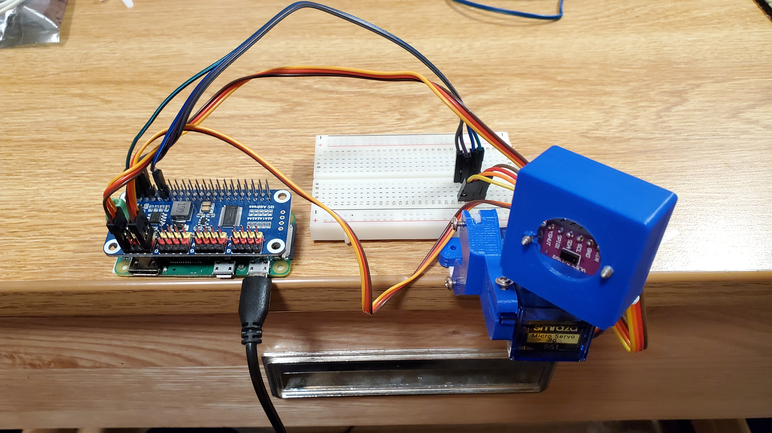
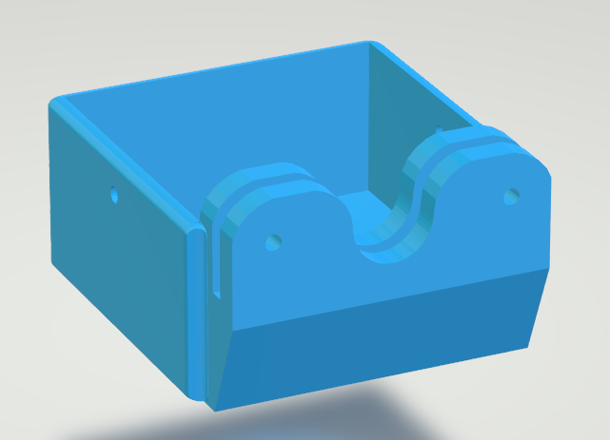
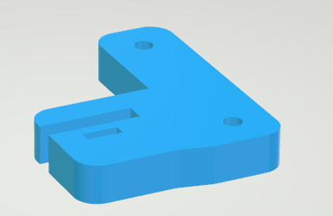
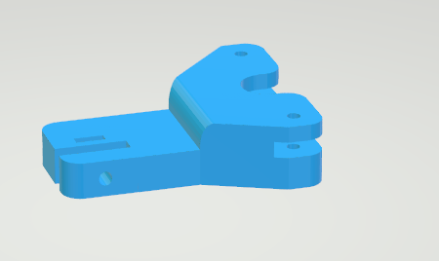
ME 134 – Homework 1 – Sawyer Paccione
Goal: Create a mapping of a room using the lidar sensor. Get Distance data and use the current pitch and yaw of the servo motors as spherical coordinates, to be converted the cartesian.
Bill of Materials:
1x Lasercut 2-Axis Gimbal
- Base Plate
- Pitch Arm
- Lidar Holder
2x Servo Motors
1x Raspbery Pi Zero W
1x Servo Motor Driver
* The Pi Zero would crash while processing the data

